Slide 1
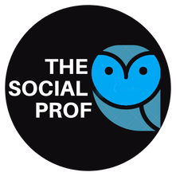
Social Media Strategy: Building it from Scratch Week #1: Generating Knowledge From Social Media for Small Business Marketing
Kellie Emrich
www.thesocialprof.com
9:00am to 12:00pm
thesocialprof@gmail.com

Slide 2
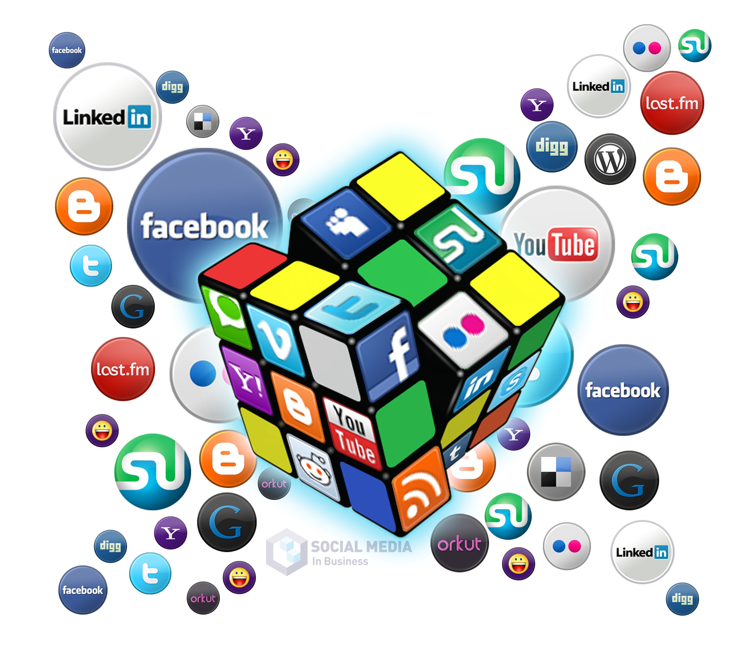
Week 1
Research
Audit
Week 2
Branding
Goals and Objectives
Platforms and Content
Week 3
Buyer Personas
Content Marketing
Week 4
Analytics
Types of Advertising
Overview of the 4 Weeks

Slide 3
Agenda – Session 1 - Generating Knowledge for use in Social Media for Small Business Marketing
Introductions
Social Media Listening and Research
The Social Media Audit
Hashtags, Keywords and Influencers
Understanding Social Platforms

Slide 4
Introductions
Link to Polls - PollEv.com/kellieemrich149
Let’s get on LinkedIn - https://www.linkedin.com/in/kellieemrich/

Slide 5
LinkedIn https://www.thesocialprof.com/linkedin.html
LinkedIn has 722 million members
More than 30 million companies use LinkedIn for business.
LinkedIn saw a 55% increase in conversations among connections in 2020
Content creation on LinkedIn increased 60% in 2020
LinkedIn the #1 Research Tool for Professional Connections

Slide 6
Research and Listening On Social Media
80% of social media marketing is providing content, and it’s imperative you intimately get to know your audience.
Researching and listening is the first step in social media marketing.
Provides intelligence and insight into Industry and potential customers.
You then develop a social media strategy with relevant, personalized, and engaging content.
Social listening allows you to track and analyze conversations about your audience, and industry online.
To solve problems
To find out what they care about
To discover what information, they need
To see what they are responding to and asking for
Understand behaviors and trends
Research Competitors

Slide 7
What to Research:
Industry, industry buzzwords
Your brand name and handles
Your product name(s), including common misspellings
Your competitors’ brand names, product names, and handles
Your slogan and those of your competitors
Search Words and Phrases
https://www.thesocialprof.com/resources-to-learn-how-to-use-social-media-for-small-business-marketing.html
Resources
www.Feedly.com and www.Hootsuite.com
Google/Social Platforms

Slide 8
PollEv.com/kellieemrich149
Complete Google and Facebook or LinkedIn research for Business Name and 2 industry Buzz words.

Slide 9
Social Media Audit - Business and Competitor Summary
Understand and optimize your own social media presence and that of your competitors
Find conversations about your industry
Find hashtags and influencers
Understand what content engages your potential audience
Social Media Platform | URL | Followers | Types of Content | Post Frequency | Engagement
Facebook | https://www.facebook.com/tlabcleveland | 2726 | Tasty Tuesdays, Teas around the world, images of different types of tea | 8/month | Limited likes and engagement 1-5/post. Not advertising or boosting posts
Instagram | https://www.instagram.com/tlabcleveland/ | 1412 | All photos with hashtags. Some captions summarizing the benefits of the type of tea | 8/month | <5 average engagement, mostly likes, not shares
Twitter | https://twitter.com/thetlabcle | 147 | Sometimes tweet about fun Friday $2 drinks. | 1 or less/month | No engagement or retweets
Pinterest | https://www.pinterest.com/tlabcleveland | 16 |  | 0

Slide 10
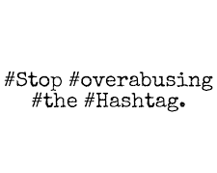
Hashtags # - the pound sign (or hash) turns any word or group of words that directly follow it into a searchable link.
No Spaces, If you want to differentiate between words, use capitals instead.
Numbers are supported; however, punctuation marks are not.
Hashtags are used on Twitter, Facebook, Instagram, Pinterest, Tumblr
There is no preset list of hashtags. Create a brand-new hashtag simply by putting the hash before a series of words, and if it hasn't been used before, voilà! You've invented a hashtag.
Hashtags are used for 2 reasons
1. To Emphasize - #howcool #sadness, #heretohelp
2. To reference/organize content in one place - #clevelandohio, #CityClub
Notes:
Keep in mind that the @ symbol does something completely different. Using @ before a person’s username/handle will post to them directly, letting them know you have written to them via the @Connect tab. A hashtag will not. Sometimes users will hashtag a celebrity’s name instead of using their @Handle/username — it is acceptable to tweet #Lorde or @lordemusic. But if you are trying to reach someone directly, don’t use a hashtag.

Slide 11
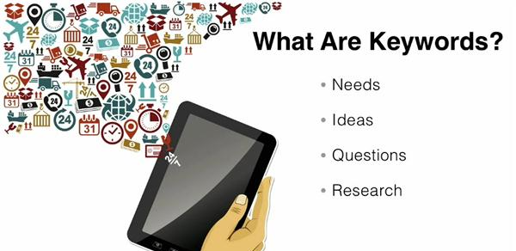
Keywords
Word's people type into search engines
like Google, and the search boxes on social
media platforms.
What would your customer type in a search box if they were looking for our product or service?
Using the right Keywords in your content means higher visibility– On search engines and social media platforms
Resources – Google Chrome Extension – Keyword Surfer
SEMrush
Google Keyword Planner
https://trends.google.com/trends/?geo=US

Slide 12
A Brief Notes on Keywords
Keywords are also important in online Advertising because often how much you pay for your ad depends on how popular the keywords you use are.
PPC – Pay per Click

Slide 13
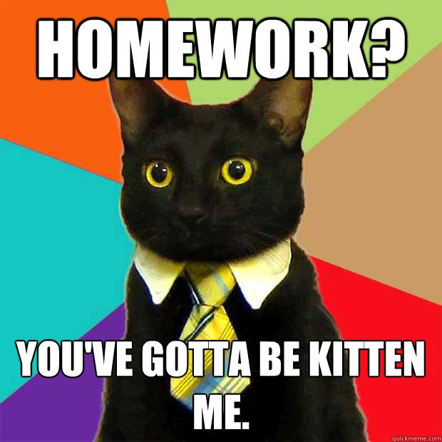
PollEv.com/kellieemrich149
Fill out the social media audit for your business.
Find a competitor on Facebook. What are they doing well and not well.

Slide 14
This Photo by Unknown Author is licensed under CC BY-N-ND

Slide 15
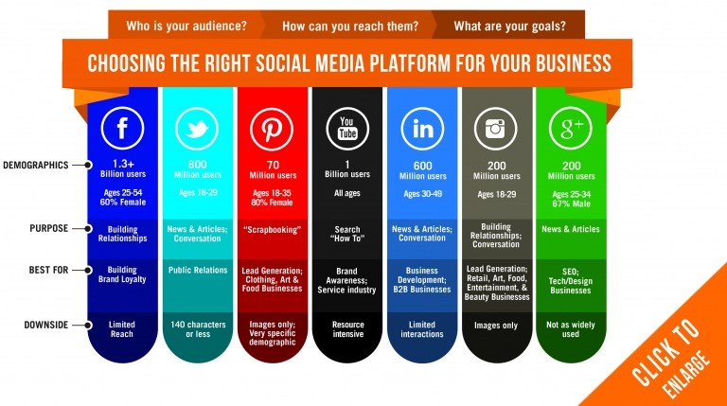
Link to 2021 data

Slide 16
How do I use Google my business?
Step 1: Sign into Google My Business. Go to www.google.com/business to sign in.
Step 2: Add your business. Enter your business name.
Step 3: Enter your location.
Step 4: Fill in your contact information.
Step 5: Finish and manage your listing.

Slide 17
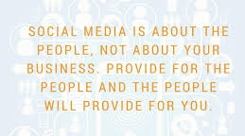
Conclusion Homework – Complete Social Media Audit and research at least 1 competitor.

Slide 18
Appendix

Slide 19
B2B vs B2C
B2C social media marketing often strives to stand out by creating something different or unique.
More than 80% of B2C marketers use Facebook, Instagram and Twitter
Content used to provide information and engage
B2B companies stand out by trying to be better than their competition, or the best in their industry.
The B2B crowd prefers blogs and reviews
90% of B2B marketers use Facebook and nearly 80% use LinkedIn as their primary social media channels.
content that helps their audience be more productive and successful with their businesses.

Slide 20
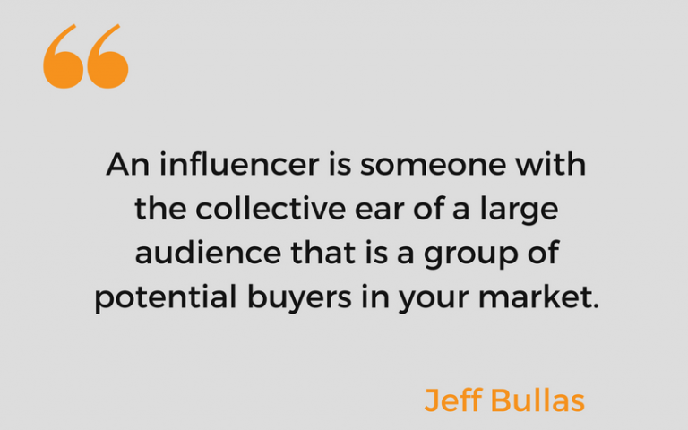
Influencers
A Social Media Influencer is a user on social media who has established credibility in a specific industry. They have access to a large audience and can persuade others by virtue of their authenticity and reach.
Influencers integrate products and services into their lives just like the rest of us, making what they promote seem special, but also relatable.

Slide 21
Influencers
For example, if you’re trying to find a social media influencer on grilling and barbecuing, you’ll want people such as:
Food critics in the industry
People with popular outdoor cooking Instagram accounts
Grilling bloggers who write for major recipe sites
Grill and barbecue pit builders
Ribs and barbecue contest judges

Slide 22
If there’s an industry, there’s an Influencer
Some industries lend themselves more naturally to influencer marketing than others. Beauty and fitness, gaming, health, fashion, and travel are some examples. But just about any industry can benefit from influencer marketing.
AdWeek lists the most popular verticals among influencers as follows:
Fashion and apparel (36%)
Food and beverage (25%)
Beauty (23%)
Fitness (7%)
Retail (4%)
Travel and hospitality (2%)
Technology (1%)
Finance (1%)

