Slide 1
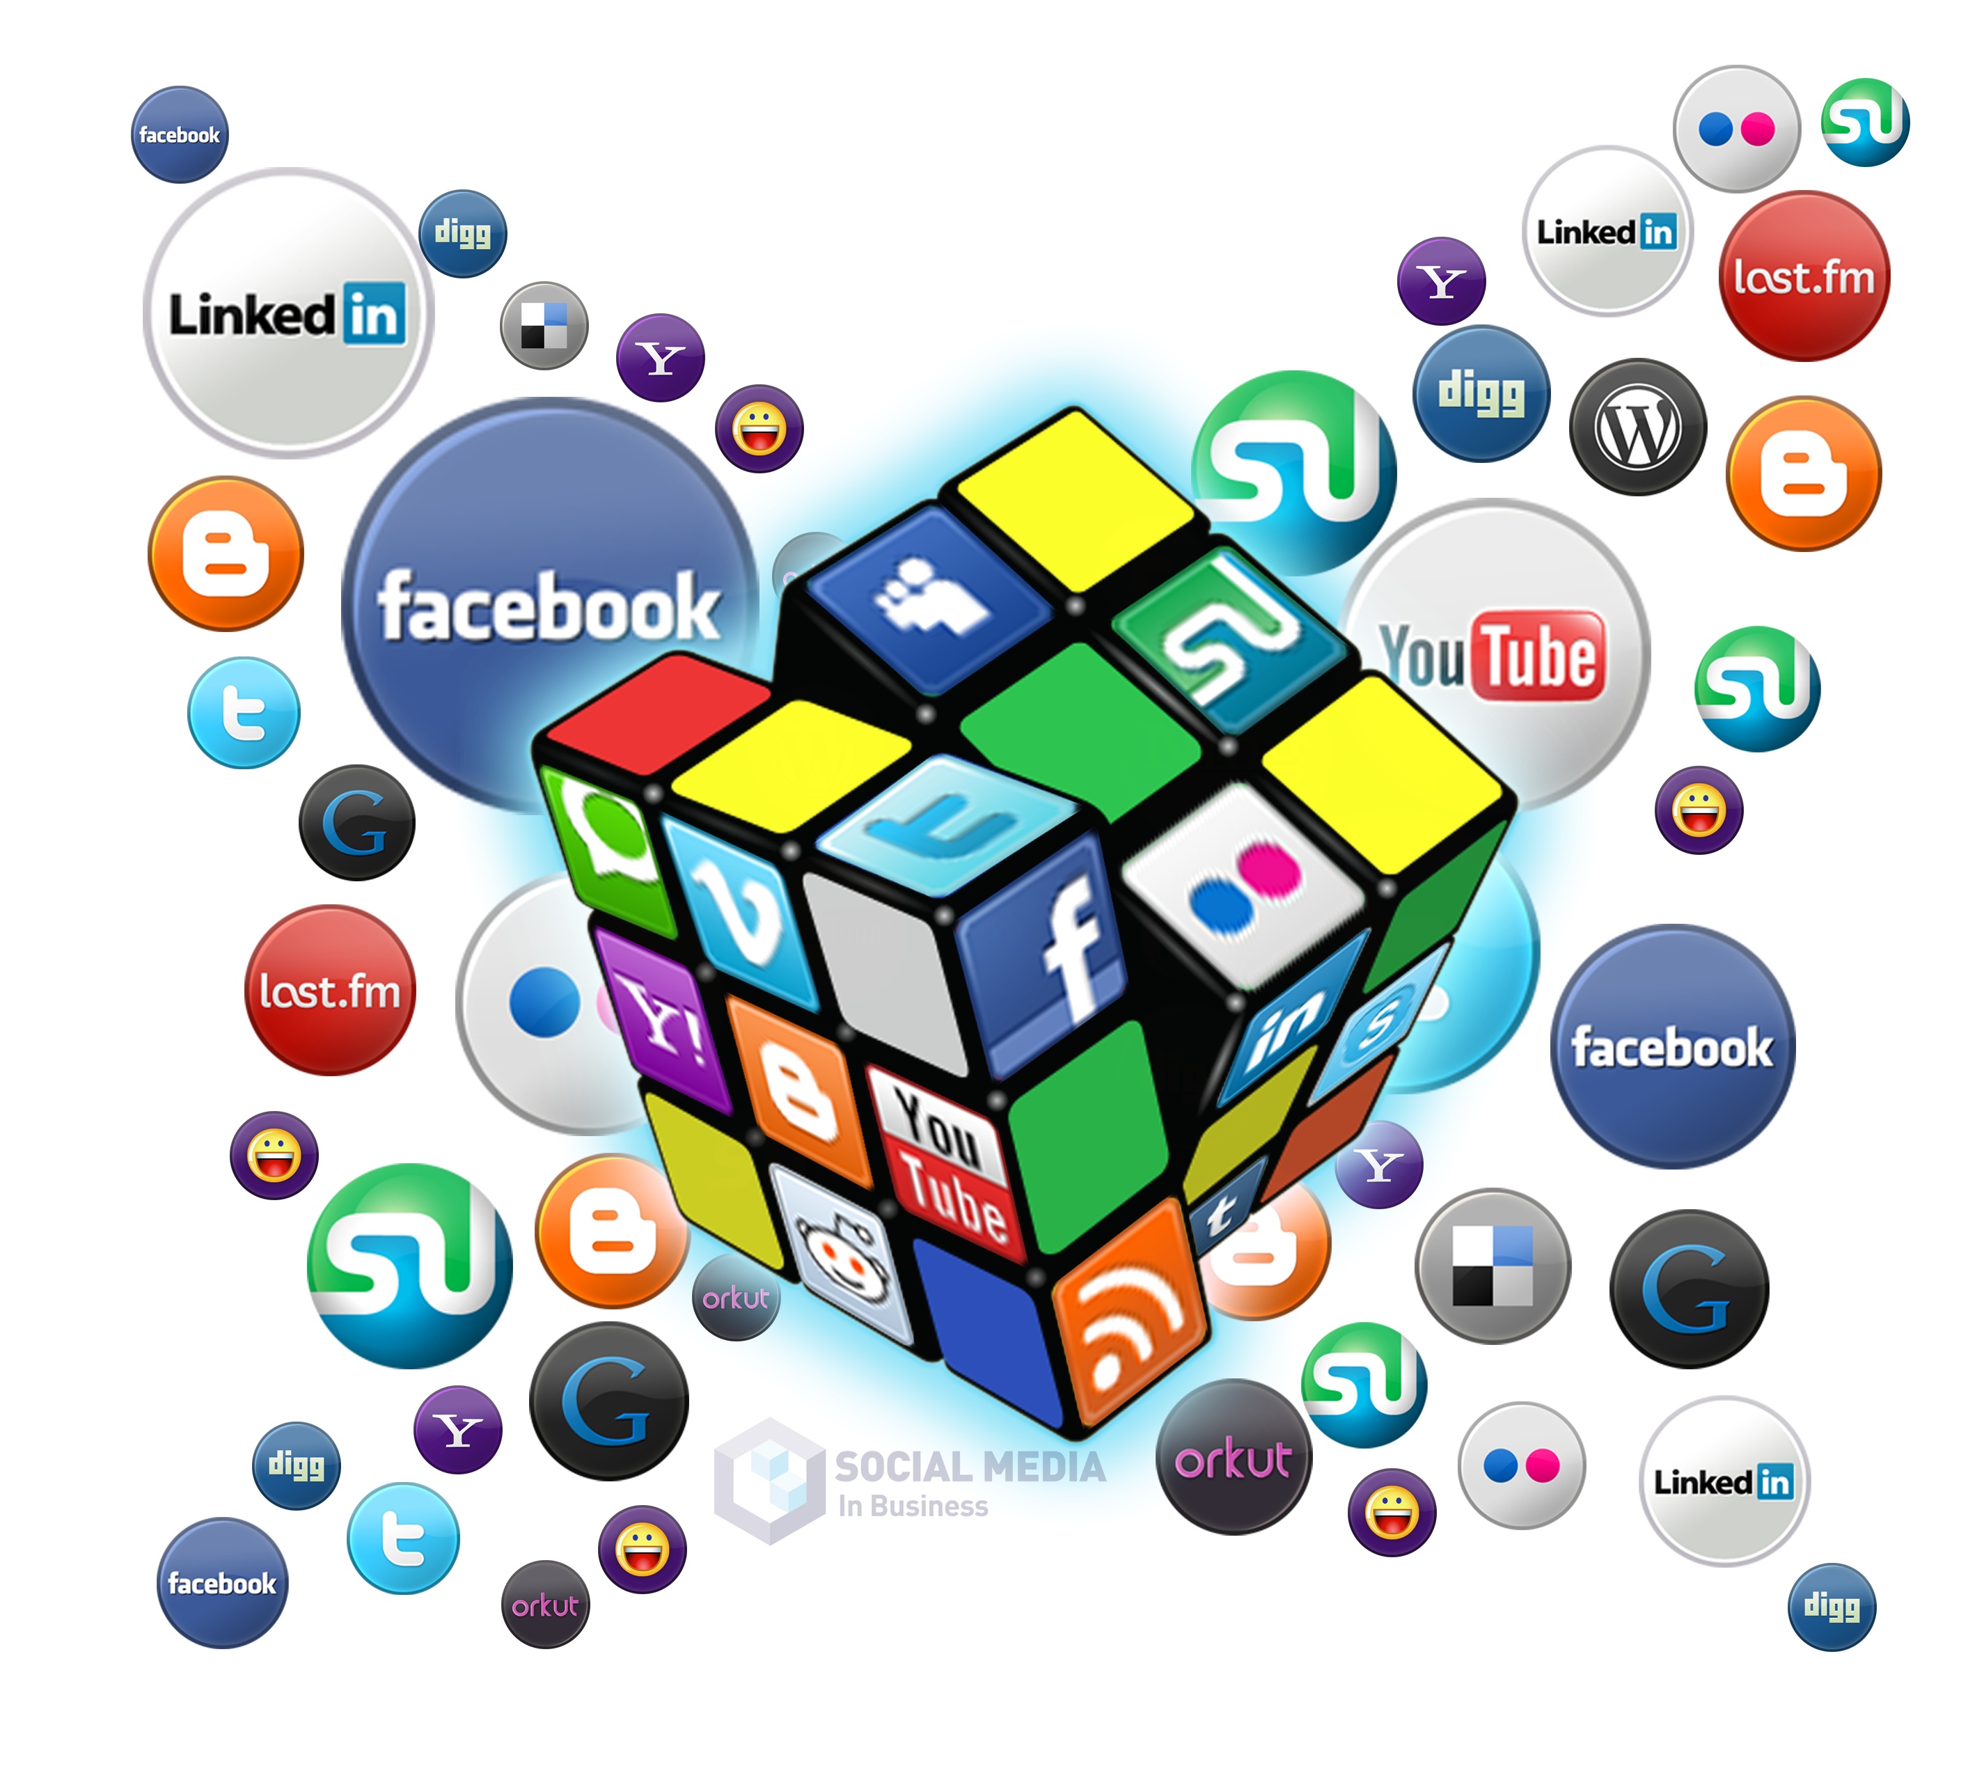
Week 1
Research
Audit
Week 2
Branding
Goals and Objectives
Optimization/Evaluation
Week 3
Content Marketing
Week 4
Analytics
Types of Advertising
The Social Media
Marketing Strategy

Slide 2
1. Research and Listening – Feedly, searching social platforms, google.
– recording results to take notice of industry, competitors, audience and your brand.
Create a social listen account on Feedly or Hootsuite
Use search engines on top platforms – Facebook, LinkedIn, Twitter, Instagram
Think like a customer – keywords - Google Chrome Extension for Keywords
Record what you find – what is working not working, content you see, tops search results, followings
2. Keep all your branding elements in one place – Brand Style Guide.
3. Pick 1-2 social platforms for your marketing efforts – Facebook is the largest and LinkedIn is a must for professional presence and network.
4. Creating Content
What Have we Learned so Far?

Slide 3
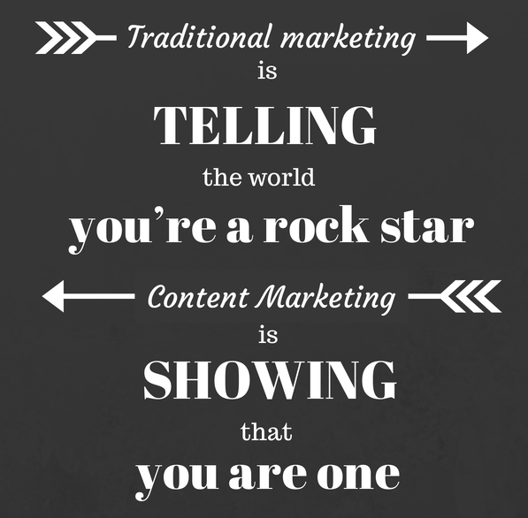
What is Content Marketing on Social Media?
Content marketing is focused on creating and distributing valuable, relevant, and consistent content on social media platforms to attract and retain a defined audience, ultimately to drive profitable customer action.
Create the Buyer Personas
Content Library
Creating Content
Content Calendar

Slide 4
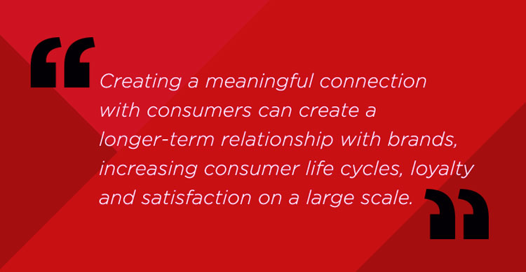
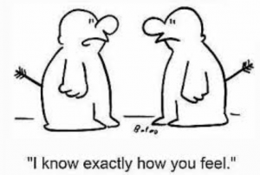
How to get started with Content Marketing?
Create Buyer Personas - A successful buyer persona summarizes who your ideal audience is, offers insights into how they think, and identifies problems they are trying to solve through your product or service.
Think about how your audience thinks and act, what problems they have, and where they go for information.

Slide 5
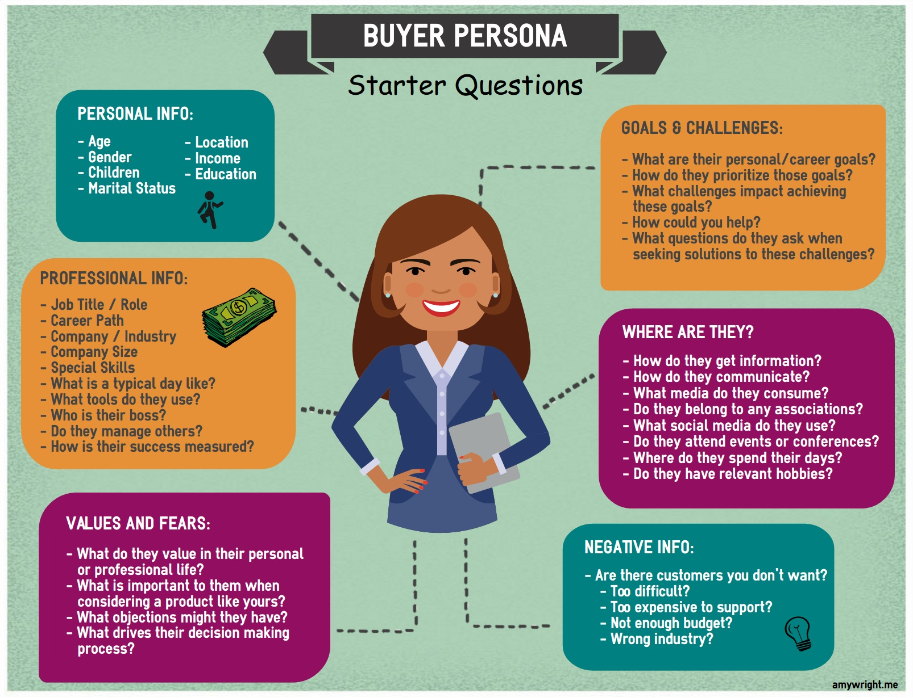
Buyer Personas
Goals and Values
What encourages them? What is their success criteria?
Sources of Information
What/who do they listen to? What matters to them?
Challenges and Pain Points
What does it feel like to be stuck with this problem?
What types of things might they need to overcome this problem?
Objections/Concerns, What discourages them? Frustrations?
Demographics
Templates
Worksheet

Slide 6
Your goal is to make a human connection. It’s about resonating with people, people that need your help or guidance.
”People don’t buy what you do, they buy WHY you do it"
Help your audience make sense of decisions
Tell why you’re doing what you’re doing
Communicating with their feelings and dealing with their behavior.

Slide 7
Activity - Worksheet
A problem your potential customer has.
A solution you can offer to him/her.
The state or a result he/she wants to achieve.
When “name of your buyer persona” 1.________ (the problem of your potential customer)
that’s why “name of your buyer persona” wants 2. ________ (the solution you can offer to him/her)
so Buyer Persona can 3. ________ (a state or a result he/she wants to achieve).

Slide 8
Activity - Worksheet
A problem your potential customer has.
A solution you can offer to him/her.
The state or a result he/she wants to achieve.
When Jane wants to travel but doesn’t have time that’s why Jane wants resources that will help her learn about travel destinations so she can enjoy the world, relax and get ideas for her next vacation.
Content Themes =

Slide 9
Content Marketing
Create the Buyer Personas
Content Library
Creating Content
Content Calendar

Slide 10
Create a Content Library
Content Ideas
Content you come across – Links, articles
Content ideas from others
Stories
From Feedly or Social Listening

Slide 11
Organizing Content
The less searching around for assets that you have to do, the better.
Hootsuite, or
Facebook Business Suite

Slide 12
Resources - Finding Content
https://search.google.com/search-console/about
buzzsumo.com
Quora
Autocomplete when in Google
Google related searches
Activity
Work in teams to find content for the following problem:

Slide 14
Content Marketing
Create the Buyer Personas
Content Library
Creating Content
Content Calendar

Slide 15
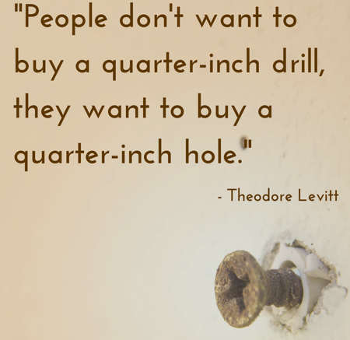
Preparing Content Talk Benefits, Not Features
People don’t care about the tool; they just want to get a benefit.
They don’t want to read books; they want to get information from them.
Not a wellness solutions, instead having more energy.

Slide 16
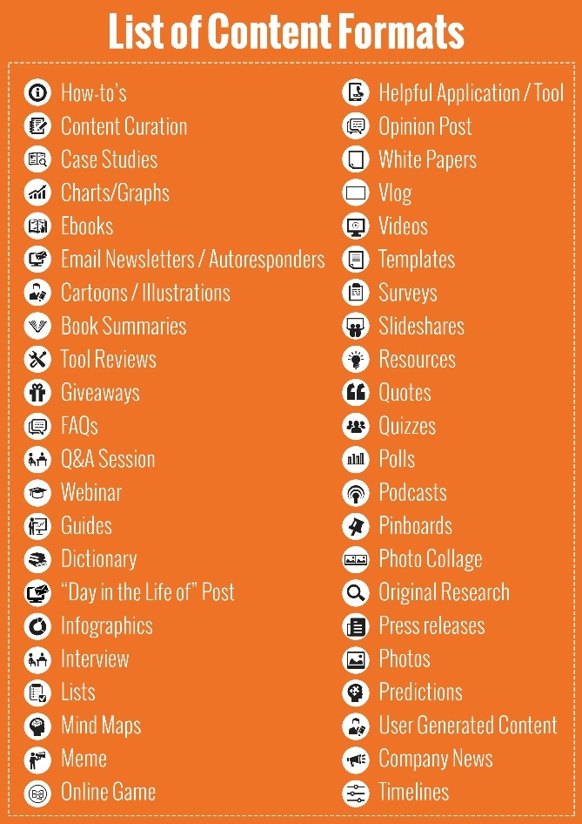
Creating Content
Telling Stories
Asking Questions
Solving Problems
Providing Information
Free trials, consultations
Articles
Using a conversational approach
Visuals

Slide 17
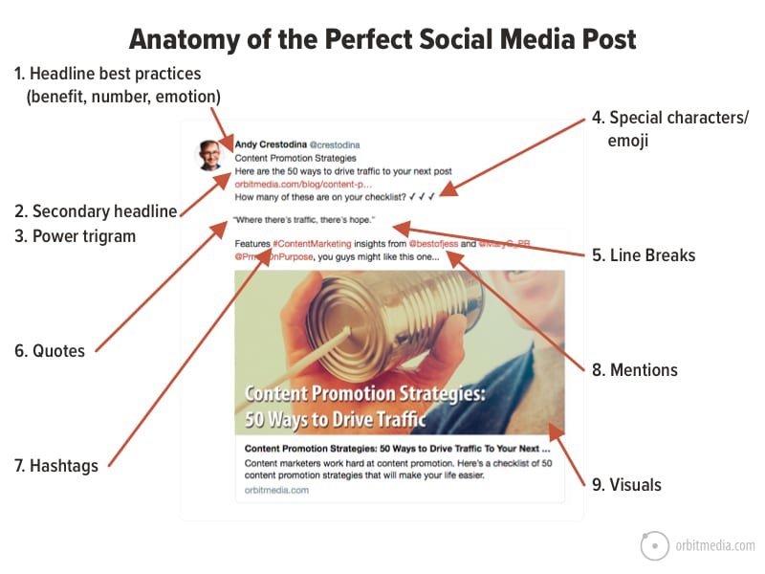
Will Make you
This is why
The reason is
10. Call to Action

Slide 18
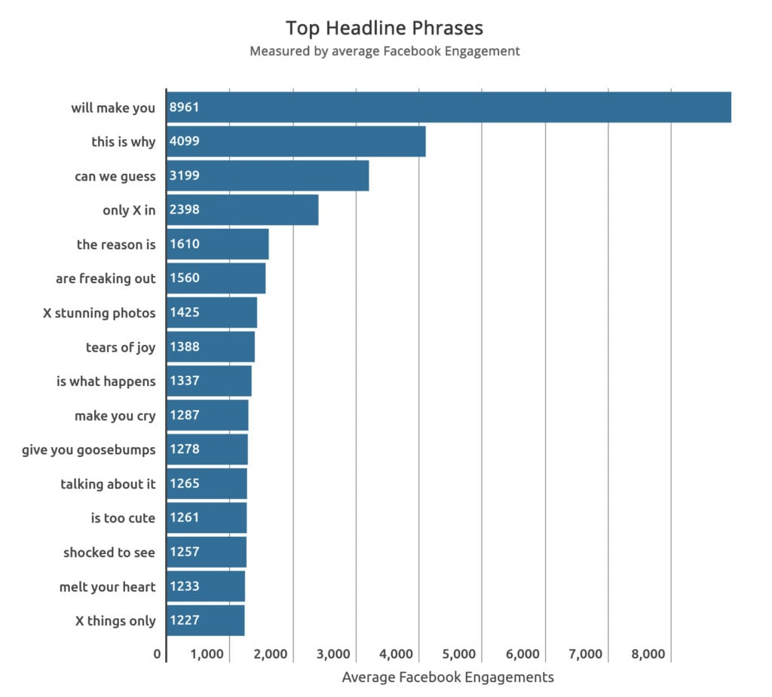
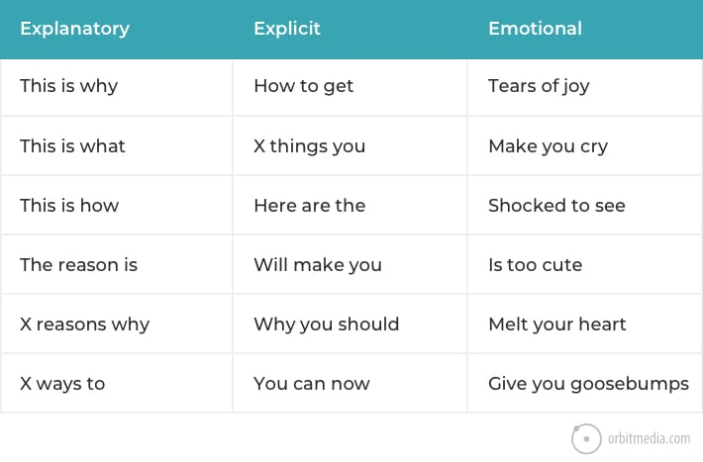

Slide 19
Headlines and Images
Headlines, Blog Title Generator
Facebook posts- First 18 Characters show in Newsfeeds
Instagram posts – First 2 lines
Images
Canva — a design game-changer. The best way to create visuals for your brand, no PhotoShop skills required.
Pixaloop — a very cool way to make your pictures move, known officially as ‘cinemagraphs’ but amongst our team as ‘Harry Potter images’.

Slide 20
Telling Stories Essential elements of storytelling: • Characters • Conflict • Resolution
Second-person point of view: • The character in this point of view is your audience. • When using "you" language, you need to really understand your buyer personas. • Tell the story in a way that shows empathy.
First-person point of view: • The character is yourself (I). • Using this type of language in storytelling is more confessional. • You can use this to build authority. • Try using first person when there is a known person, an author, behind the content.
Third-person point of view: • This is the ”he said” and "she said” type of language. • Case studies about your customers are a good example of using third-person. • Stories for this point of view can be both fictional or nonfictional.
Most importantly, when it comes to point of view, keep it consistent. And tell the story of a person.
Notes:
The conflict is the lesson in how the character transforms through challenge.
If your story lacks conflict, then you’re probably not telling a story. Instead you’re telling a pitch, tagline, unique selling point, or a plain statement.
The resolution should wrap up the story but should also clearly call your audience to action. It fulfills the purpose behind the story.

Slide 21
Preparing Content - Tell Stories
Use Stories, from a single person perspective
“Our safe room against burglars has helped out thousands of people feel secure and safe.” This sentence doesn’t really appeal to anyone or strike at any emotion.
On the other hand, a story about a single person just might.
“John was sleeping one night at home with his wife and his newborn infant. Suddenly, he heard a noise from the kitchen. He immediately woke his wife up, ran to his kid, and they locked themselves in the safe room from where they called the police. The police came within five minutes and apprehended the burglars. John kept his family safe by using one of our safe rooms.”
Suddenly, we care. Talk about the experience of a single person and paint the picture.

Slide 22
Content Marketing
Create the Buyer Personas
Content Library
Creating Content
Content Calendar

Slide 23
LA Fitness
@LAFitness
·
Apr 2, 2021
“I don’t count my sit-ups; I only start counting when it starts hurting because they’re the only ones that count.” – Muhammad Ali #MotivationMonday
Content Calendar
Find a Cadence
Maintaining a consistent posting schedule is important if you want to stay visible and relevant on social platforms.

Slide 24
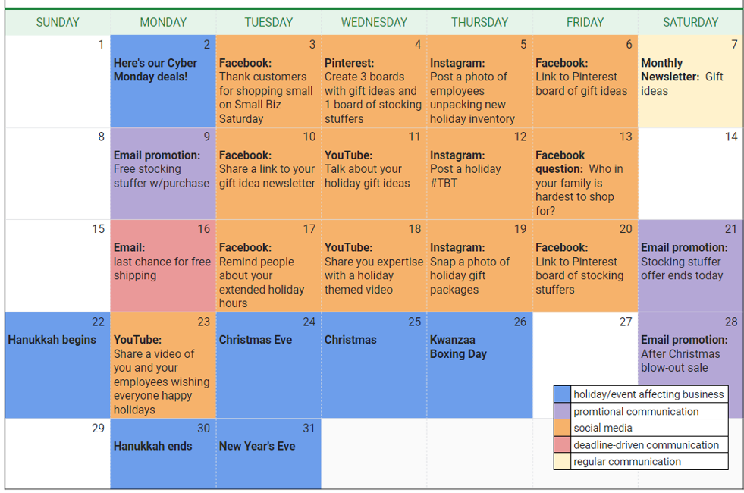
LA Fitness
@LAFitness
·
Apr 2, 2021
“I don’t count my sit-ups; I only start counting when it starts hurting because they’re the only ones that count.” – Muhammad Ali #MotivationMonday
Content Calendar
Find a Cadence
Maintaining a consistent posting schedule is important if you want to stay visible and relevant on social platforms.

Slide 25
Conclusion
Create the Buyer Personas
Content Library
Creating Content
Content Calendar

Slide 26
Checklist
Talk to a Buyer Persona
Define the purpose, talk benefits not features
Be engaging and conversational
Use your brand voice
Use visuals
Hashtags and Mentions
Track Results and Adjust
Include Call to Action
Create a Content Library

Slide 27
Content Specific Landing Pages
Landing pages are designed to get people to perform a single action, whether that’s entering their email address, or clicking on an offer.
Used for PPC or Email Marketing
a page that is specifically designed to receive and convert traffic from an online marketing campaign.
a home page wouldn’t qualify as a “landing page“—it isn’t designed to convert traffic from a specific marketing campaign.

Slide 28
Landing Pages
Here are a few examples of things you might want people to do on your landing page:
Make a purchase
Become a lead by submitting a form
Subscribe to a newsletter or email list
Register for an event
Generate Leads by performing an action
Specific Offers - Give Offers a Place to Live

Slide 29
Format of a
Landing Page
Main Headline
Supporting Headline
Call to Action - The CTA is simple and consistent throughout the page. In addition, the CTA is obvious and straightforward. Most people on the internet are looking for quick information, so the easier you make it for them to find and absorb your CTA, the more likely they are to convert.
For example, “Get Your Free Quote!”, “Contact Us Now!” or “Get Started Today” are great examples of CTAs.
Image
Bullet Points of Benefits - Essentially, your benefit summary should say, “Hey, here’s what you’ll get if you do what I’m encouraging you to do. See how great it is? You should either convert or scroll down to learn even more!”
3 Images with Benefits - The important thing is to keep the focus on how you will make their life easier—not how awesome your business, product or offer is.
Social Proof
Testimonial, Logos, Social Sharing Buttons
Reinforcing Statement - good landing page should naturally lead a user to the conclusion that converting is in their best interest. To do that, however, you need to know exactly what you want them to do and why they might not want to do it. Then, throughout your landing page, you address their concerns and sell them on the value of what they get in exchange for converting.

Slide 30
Ultimate Landing Page Checklist
Does my headline define my business/service/offer?
Does my headline and subheading communicate value?
Do I have an obvious, above-the-fold CTA?
Does the color of my CTA contrast with the color of the rest of my page?
Does my CTA clearly indicate what the user will get for converting?
Is my landing page free of unnecessary links?
Does my page feel clean and uncluttered?
Is my copy focused on benefits rather than features?
Do my testimonials sounds “real” and are they in line with the overall message of my page?
Am I only asking for the information I need on my form?
Have I added a page title to my landing page?
Does my landing page meet the expectations set by the ad(s) that are sending traffic to it?
Has someone else proofread my page?
Have I tested all of my buttons and forms to make sure they are working (and properly integrated)?
Is my page optimized for mobile traffic?

