Slide 1
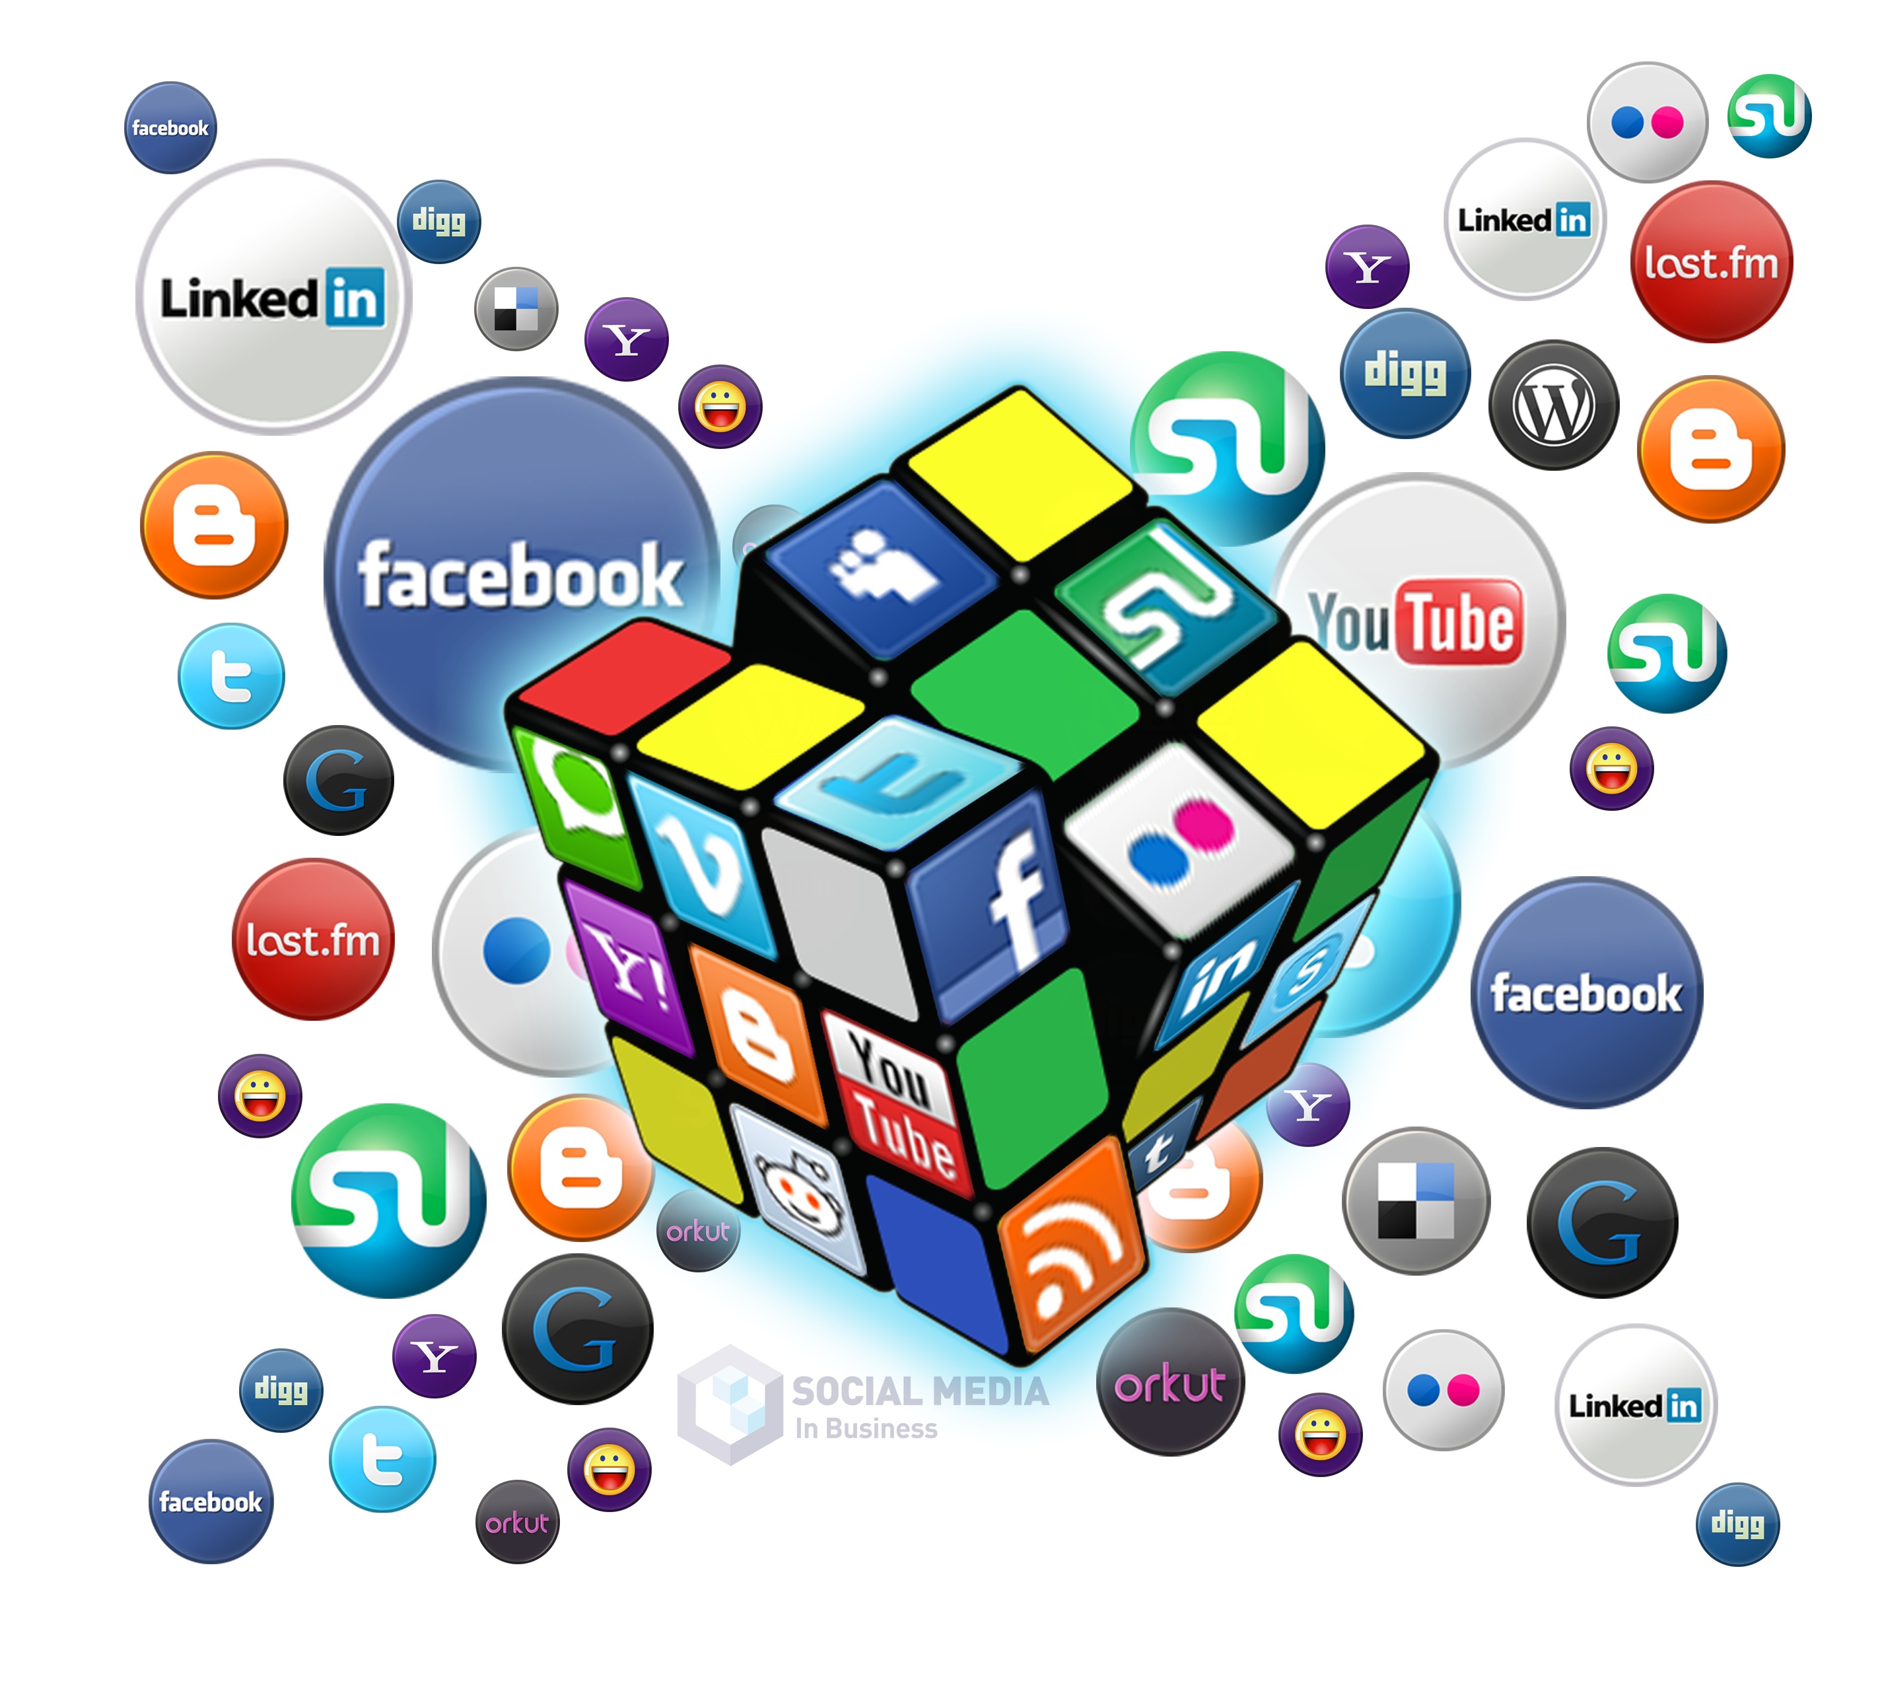
Social Media Strategy: Building it from Scratch
Week 1
Research
Audit
Week 2
Branding
Goals and Objectives
Optimization/Evaluation
Week 3
Buyer Personas
Content Marketing
Week 4
Analytics
Types of Advertising
Assess email marketing as a
component of a social media
marketing strategy
Download all Week 4 Materials Here – https://www.thesocialprof.com/socialmediatrainingjumpstart.html
Kellie Emrich
9:00am to 12:00pm
thesocialprof@gmail.com

Slide 2
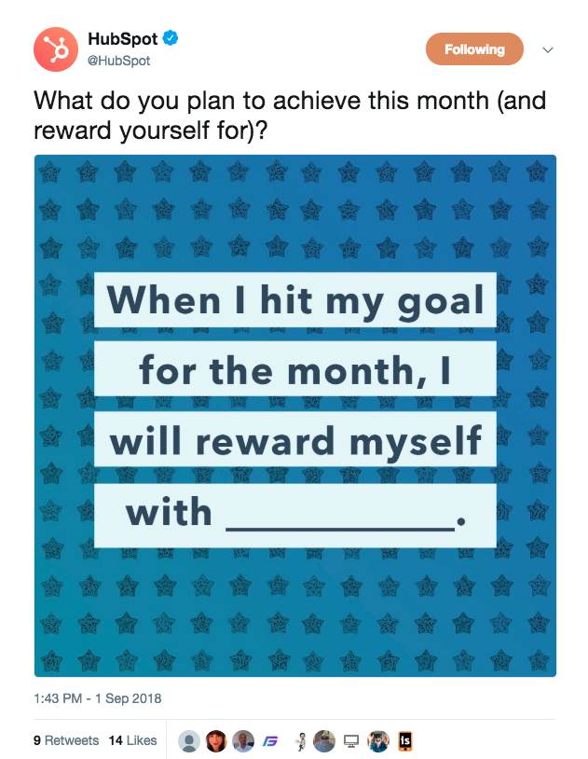
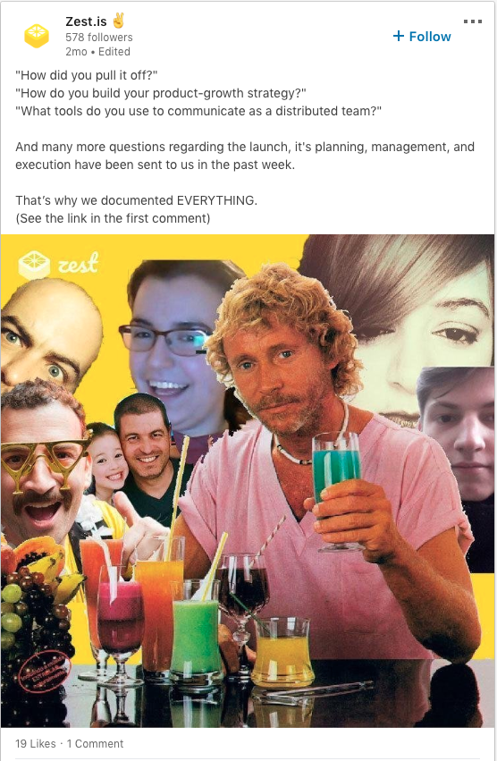
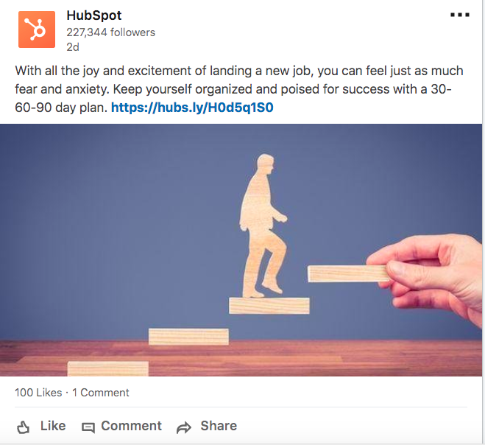
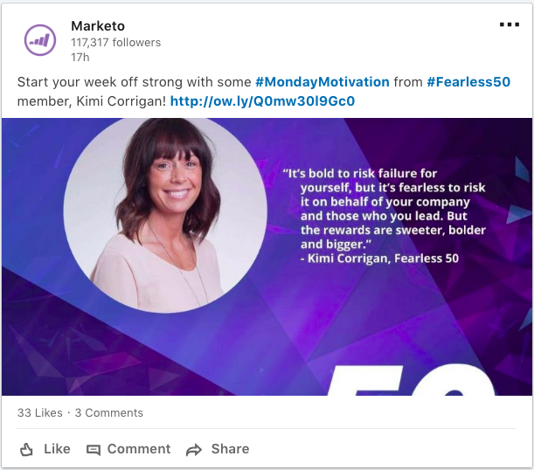
Example Posts
on Social Media

Slide 3
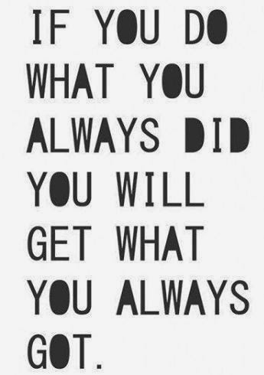
Are your posts working? How to improve posts?
Are you publishing content at the right time of day? Social Media heat Maps
Rank your posts by KPI
Compare Posts - Analyze your top posts. What worked and why? How do they compare to your lower-performing posts?
Review the creative used – Image? Videos? How might they have influenced your audience’s actions?
Did you use a Call to Action? Did it work? Try something different.
Did you use Headers, impactful words?
Was your post to much like a paragraph? Do you need less copy and more spaces and emojis?
Did you use the right hashtags? Is there anyone you can tag?
If you have a single post in a month that doesn’t perform to your standard, that doesn’t mean you should immediately throw that content out altogether. Instead, look for patterns over time, just as you would for successful posts.

Slide 4
Do you have a post we can look at and help Improve?

Slide 5
How to Use Social Data Analytics to Inform Your Marketing Strategy Social media data is the collected information from social networks that show how users share, view or engage with your content or profiles.
Core social media KPIs help marketers to analyze data and target the unique metrics from each social media platform.
Many platforms now offer native analytics tools to better enable marketers to track and analyze data. Facebook Insights, Twitter Analytics, and Google Analytics are a few of the platform tools available for social media analysis.
Both tracking KPIs and social network analytics helps marketers find out what posts and content performs best and how to leverage social networks accordingly.

Slide 6
Identify New Initiatives to Start
Stop Activities That Aren’t Working
Scale Activities That Are Working for You
Scaling refers to the activities that are already working for you that you can double-down on.

Slide 7
Core Metrics/KPI’s
Social Media Analytics
Social Proof and Brand Awareness - Followers
Increase Awareness - Impressions & reach
Impressions are how many times a post shows up in someone’s timeline
Reach is the potential unique viewers a post could have (usually your follower count plus accounts that shared the post’s follower counts).
Increasing engagement
Shares, Likes, Comments
Clicks and Leads
Increase Conversions
On Facebook
On Twitter

Slide 8
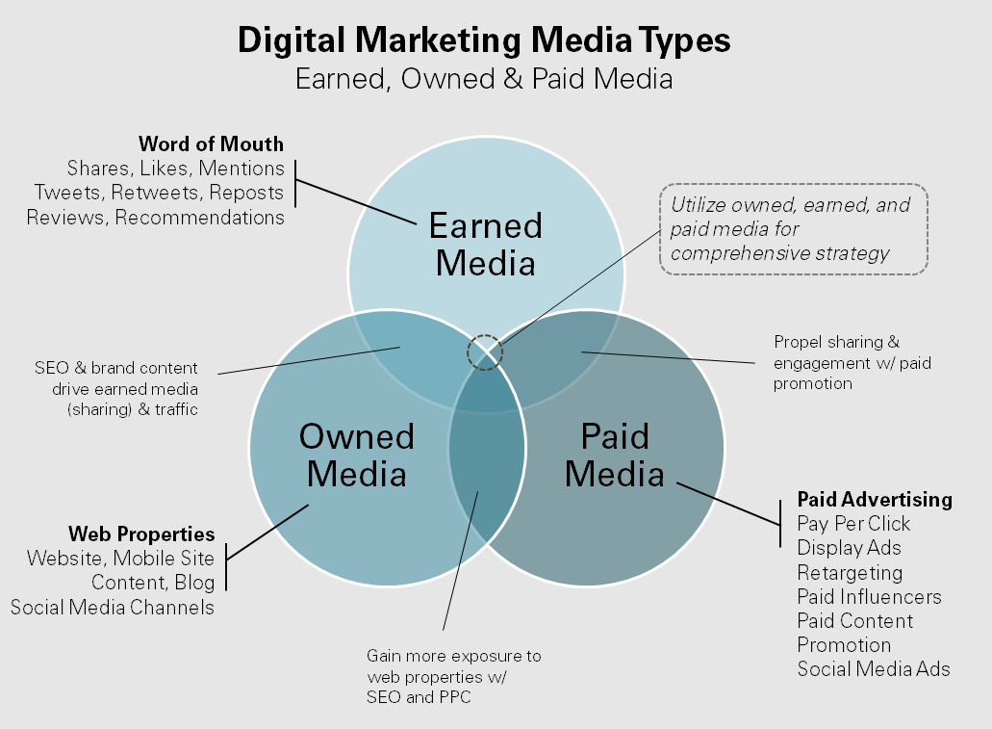
More Digital Options for your Social Media Strategy
Promotional Mix
Owned - Website
Owned/Earned - Email
Owned - Social Media Accounts
Paid - Paid Digital
Paid - 1 Pagers
Earned/Paid - Public Relations
Write out your Promotional Mix and identify Paid, Owned, Earned

Slide 9
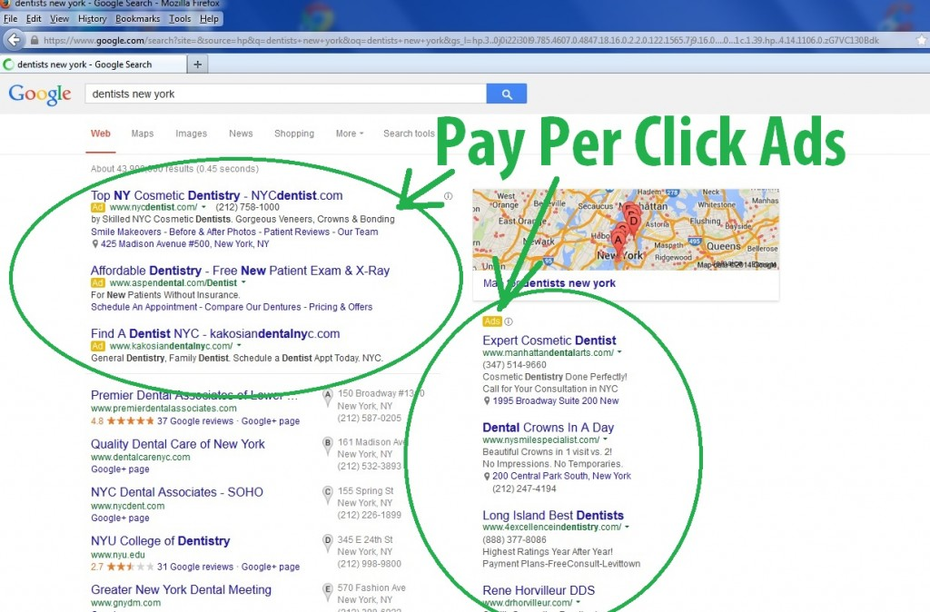
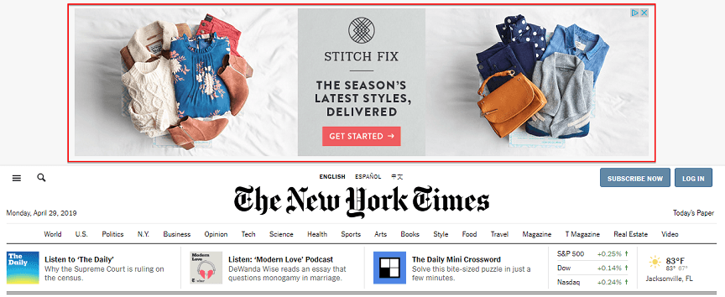
Paying for Advertising Online
1. Social Media Ads and Boosted Posts
2. Pay Per Click
3. Digital Display

Slide 10
When to Pay for Social Media Advertising
Paying for Advertising Online
Paid Social Media Advertising – Paying to have specific audiences see your content
Social Media Ads
Boosting Posts
Digital Display Advertising - https://ads.google.com/
Pay Per Click - You pay only when someone clicks your ad.
Notes:
With PPC, you’re not paying for a promise, and you’re not paying to load an ad onto a page. You’re paying for an actual result, a click. With PPC, you don’t pay if nobody sees your ad, and you don’t even pay if someone does see it but doesn’t click. You pay only when someone clicks your ad. In the business, people talk about buying clicks because that’s just what they (and you) are doing. You’re paying a PPC company each time someone clicks a link pointing to your Web site.
Social media advertising is a way to target audiences on specific networks through demographic information so targeted consumers can see your brand in their feeds. And it works really well when done right. But pushing paid content in front of random social media users isn’t going to immediately work or perform well at all. You have to be strategic with your ad spend, content selection, targeting frequency and audience demographics. There’s a social media ad solution for every budget, from just a few dollars a day to million-dollar campaigns.
Ads on most social networks are sold in an auction format. You set a maximum bid for a target result (such as a click), or a maximum budget per day. There’s no set amount to pay. As you create your ad, the ad manager interface will provide a recommended bid based on your stated goals.
You will generally pay using one of these methods, depending on your campaign goal:
Cost per click (CPC)
Cost per 1000 impressions (CPM)
Cost per conversion
Cost per video view

Slide 11
When to Boost a Post
Paying for Advertising Online
Audience engagement on your Page
Develop your brand awareness
Maximize visibility for your best weekly organic post
Grow your audience of page likes
Website Clicks
Local business Promotions or giveaways

Slide 12
Use Targeting Features - Behaviors, Demographics, Interests
Paying for Advertising Online
Interest Targeting - target solely on interests and things that users like and share on their own Timeline.
Audience Behaviors - Target a specific intents like purchasing behaviors or traveling intentions. All these things lead to sales and with the right behaviors selected, you’ll see those who are active with brands that relate to you.
Core Demographics - You should research and try different demographics of your network to understand how audiences will react to your ads.

Slide 13
What goes into a Social Media Marketing Strategy?
Listening and Research – Feedly
Social Media and Google Audit
Consistent Branding
Buyer Personas
Focused Social Media Platforms
Creating Content – Content Cadence and Content Calendar
SEO
Budgeting
Analytics

Slide 14
The End of Session 4
Questions

Slide 15
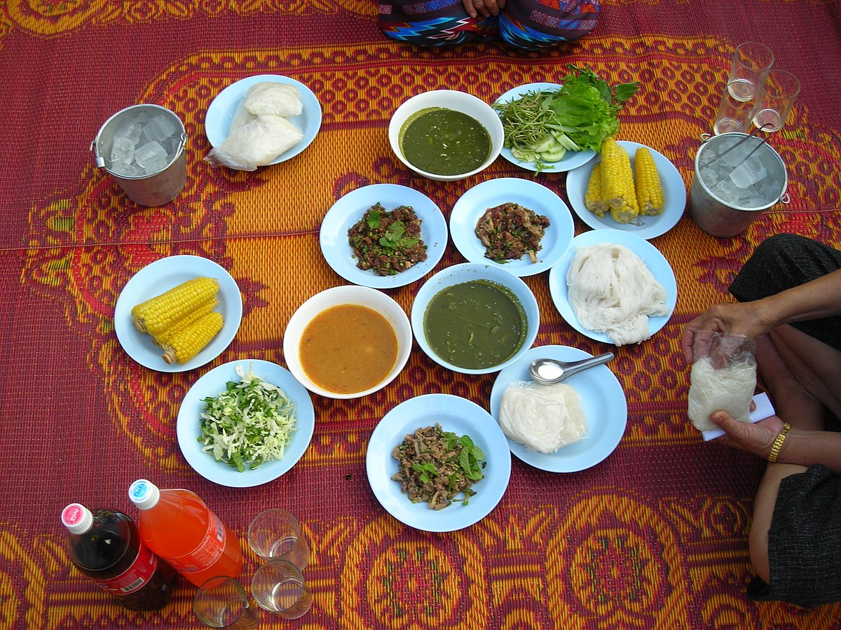
Think of social media data as the ingredients of your meal and the analysis as your recipe. Without the recipe, you wouldn’t know what to make or how to cook it. The more data you’re able to collect, the more informed decisions you can make, all leading to a better result.
This Photo by Unknown Author is licensed under CC BY-SA

Slide 16
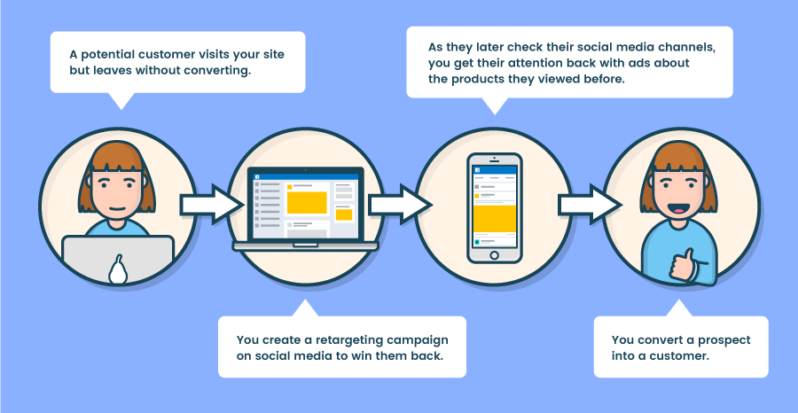
Remarketing on Social Media
Remarketing is a technique that involves redirecting people who visited your site back to your site. Social advertising is a great way to remarket.
Remarketing can increase intended clicks by 400% and double revenues.
Resource

